Slide 1
Topic : Trigonometry
EQ: What is the cosine ratio and how can I apply it to right angled triangle ?

Slide 2
Mental Maths
If you are given the two sides of a right angled triangle that are not the hypotenuse, which trig function should you use ?
What is the symbol for the Greek letter beta ?

Slide 3
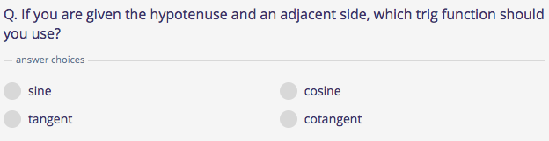
Mental Maths
Write a equation to represent the pythagorean theorem ?
Clue.. SOH CAH TOA

Slide 4
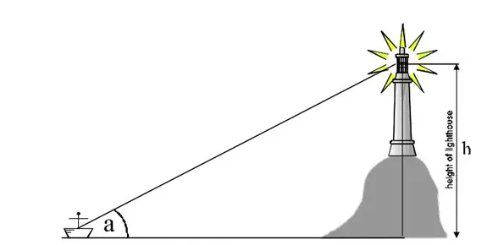
Real life applications of trigonometry
Shipping companies use trigonometry to navigate the seas.

Slide 5

The Cosine Rule for finding an angle

Slide 6

What is the cosine ratio?

Slide 7
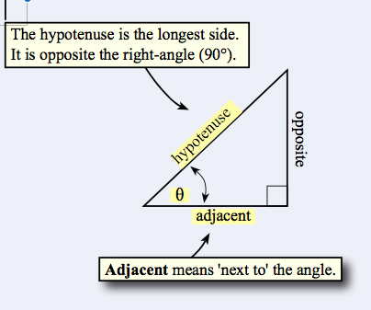
For example

Slide 8
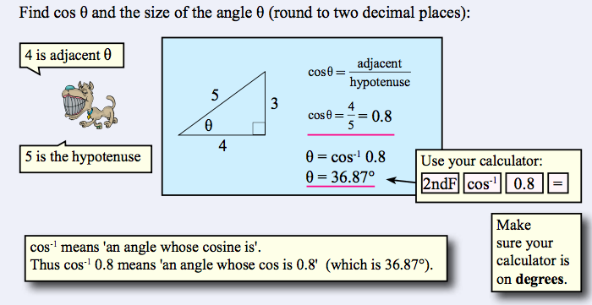
For example

Slide 9
The Cosine Ratio examples
Now complete exercise 17.4 page 233 in the Dwyer Textbook Q1-6.
Please draw and label each triangle in your textbook.

Slide 10
Activity Outside
If time permits please head outside to the area in front of the sports building. Using a trundle wheel measure a distance of 10 metres from the base of the building. Then in pairs using a clinometer record the angle of elevation to the top of the sports building.
At this point you should be able to accurately deduce the height of the building in metres using your knowledge of trig and as a bonus question estimate and calculate how many times the sports building is higher than yourself. Show all workings.

Slide 11
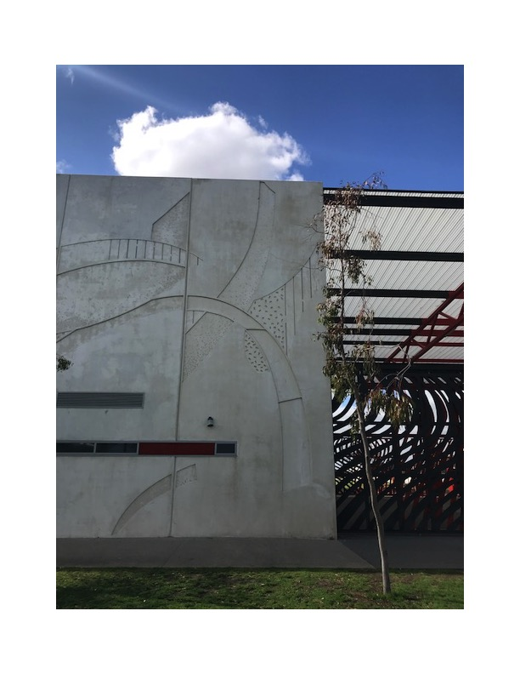
Activity Outside

Slide 12
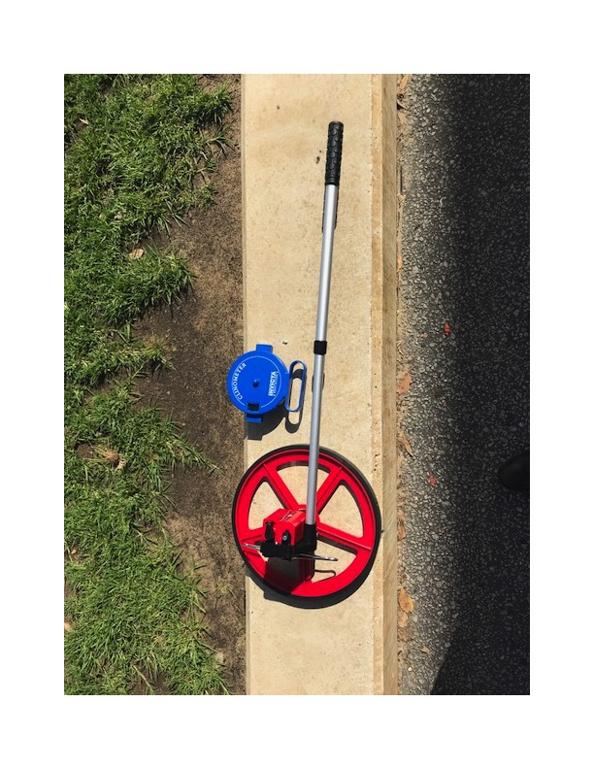
Activity Outside

Slide 13
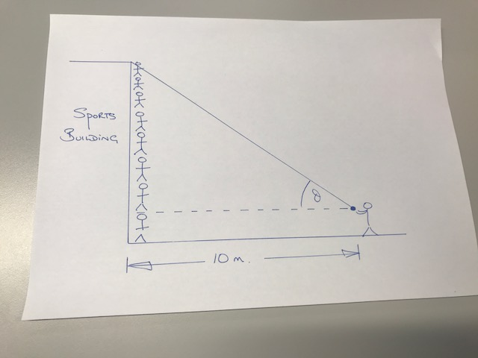
Activity Outside

